Slide 1
ViviendasLeón
Sustaining & Connecting Communities
León, Nicaragua and Santa Lucía Utatlán, Guatemala

Slide 2
Our Mission
ViviendasLeón alleviates poverty by empowering and equipping rural communities to be the agents of their own transformation
_______________________________________
Our development program empowers rural families to improve their standard of living by building their capacities in areas of resilience, self-esteem, cooperation and leadership, while training for environmental stewardship, farming, water management and small business development.

Slide 3
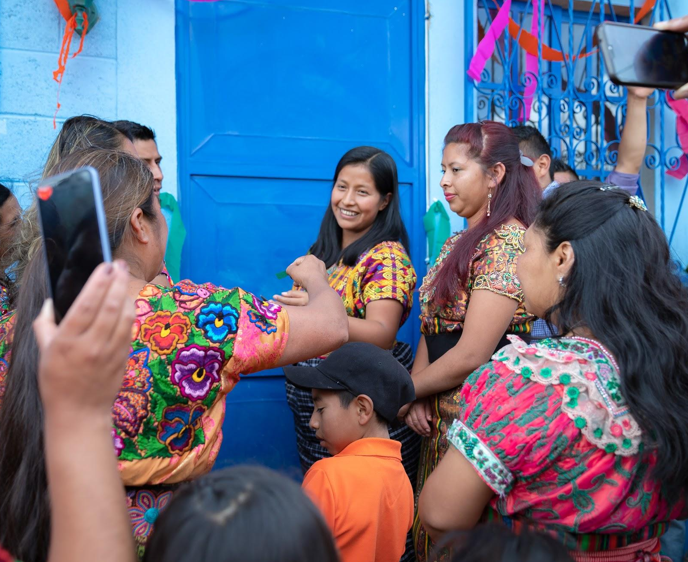
Our Vision
Expand within Central America to increase our impact
Empower rural communities to become a contributing sector of socio-economic growth
Become a leader in human training and community development

Slide 4
Human-Centered Development Program
Human Development
Emotional, Intellectual, and Technical
Survey
+
Census
Community
Development
Plan
HCT
- Socio-emotional (1)
- Education (2)
- Leadership (3)
- Environment (4)
- Economic(5)
Projects
- Farms (2)
- Water (3)
- Sanitation (5)
- Reforestation (1)
- SMEs (4)
Human Development
Sustainable Development
Analysis
Foundational Training
Projects address
interconnected needs
Goal

Slide 5
Sutiaba, León, Nicaragua
Historically indigenous land, Sutiaba lies west of the city of León. It has an area 135 square miles and a rural population of 10,900. Sutiaba is characterized by small communities, formed by clusters of indigenous family lands ranging in size from less than one acre to more than ten. Sutiaba like many rural populations, suffers from chronic undernourishment, struggling with an unreliable food supply and a history of dependence on international food aid.
80% of rural families depend on agriculture for their livelihoods
17.3% of children under 5 y/o are malnourished
Average years of schooling is 6.8 years with a primary school drop-out rate of 51.6%
The national poverty rate is 58%, with 24.9% living in extreme poverty
Of this group 66% live on a little more than $1 a day with 80% of the indigenous population living on less than $1 per day
More than 50% of the national population is either unemployed or underemployed
Critical Community Issues:
> Low levels of education among the adult population and poor quality education among youth.
> Malnutrition in the general population leading to poor cognitive development and chronic illness.
> Social corrosion in families and communities.
> Unemployment, lack of economic development or activity.

Slide 6
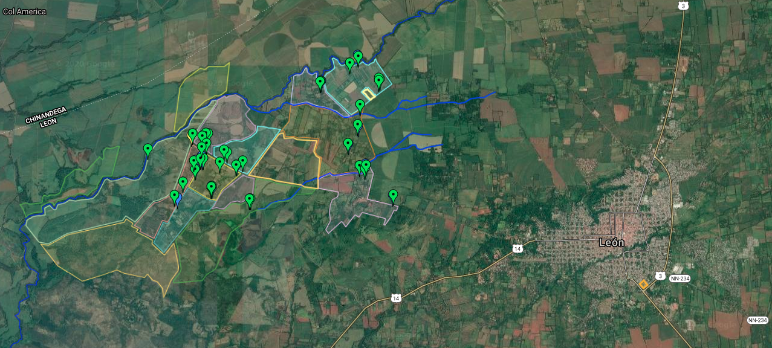
Troilo and Goyena, Sutiaba

Slide 7
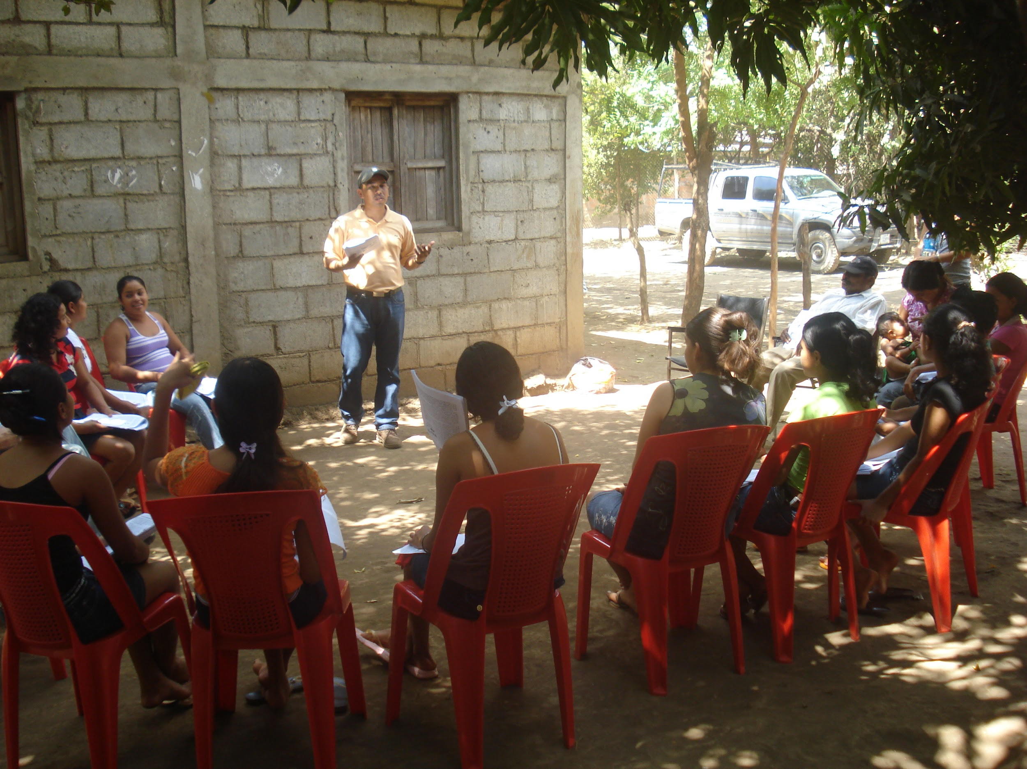
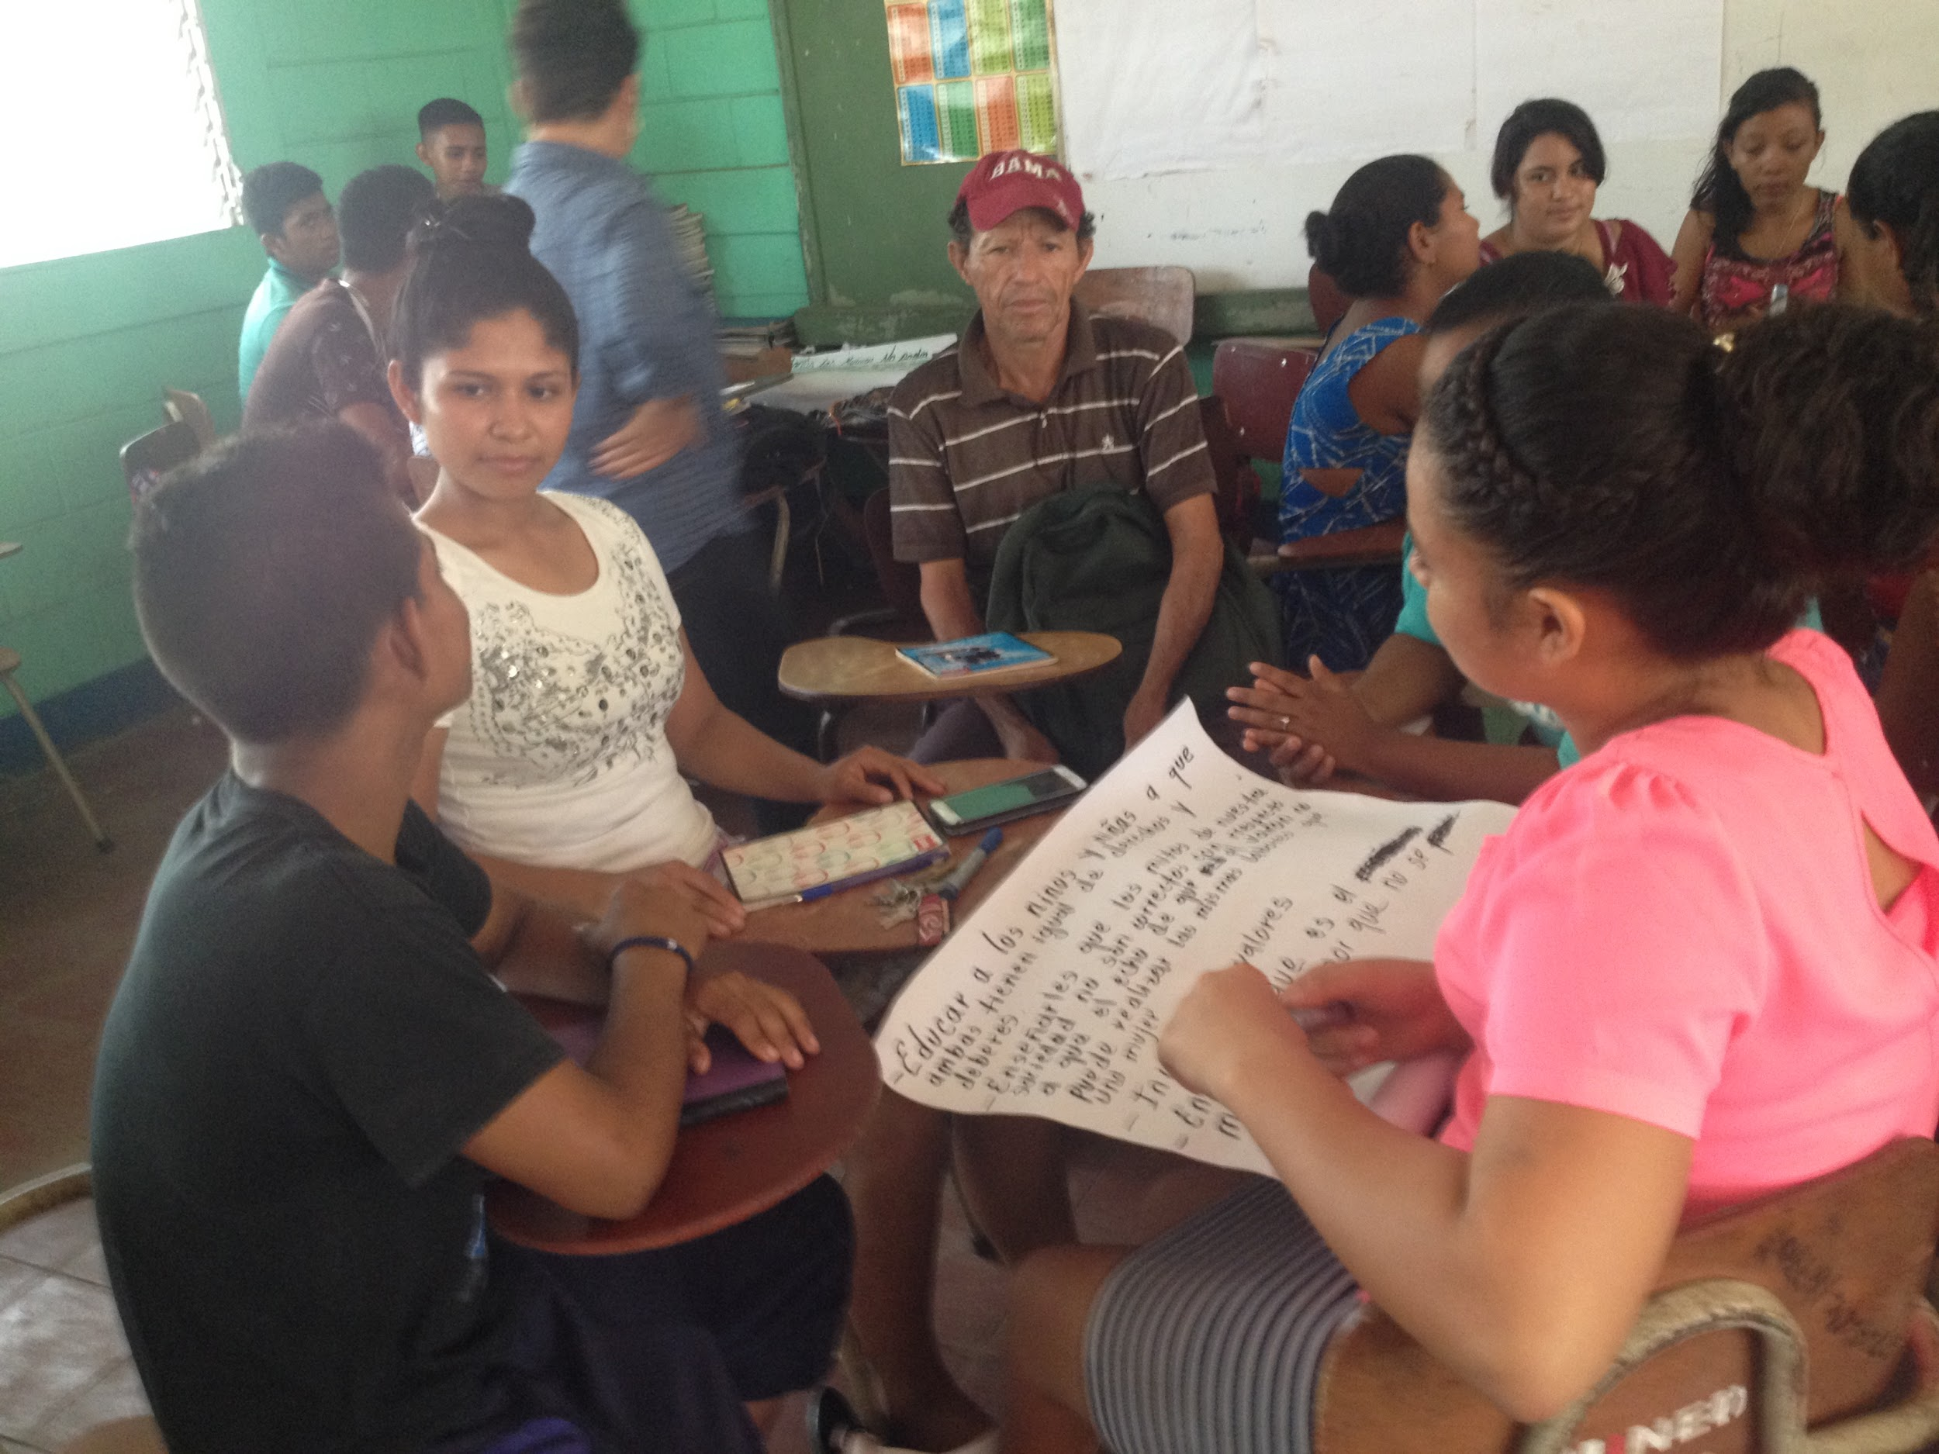
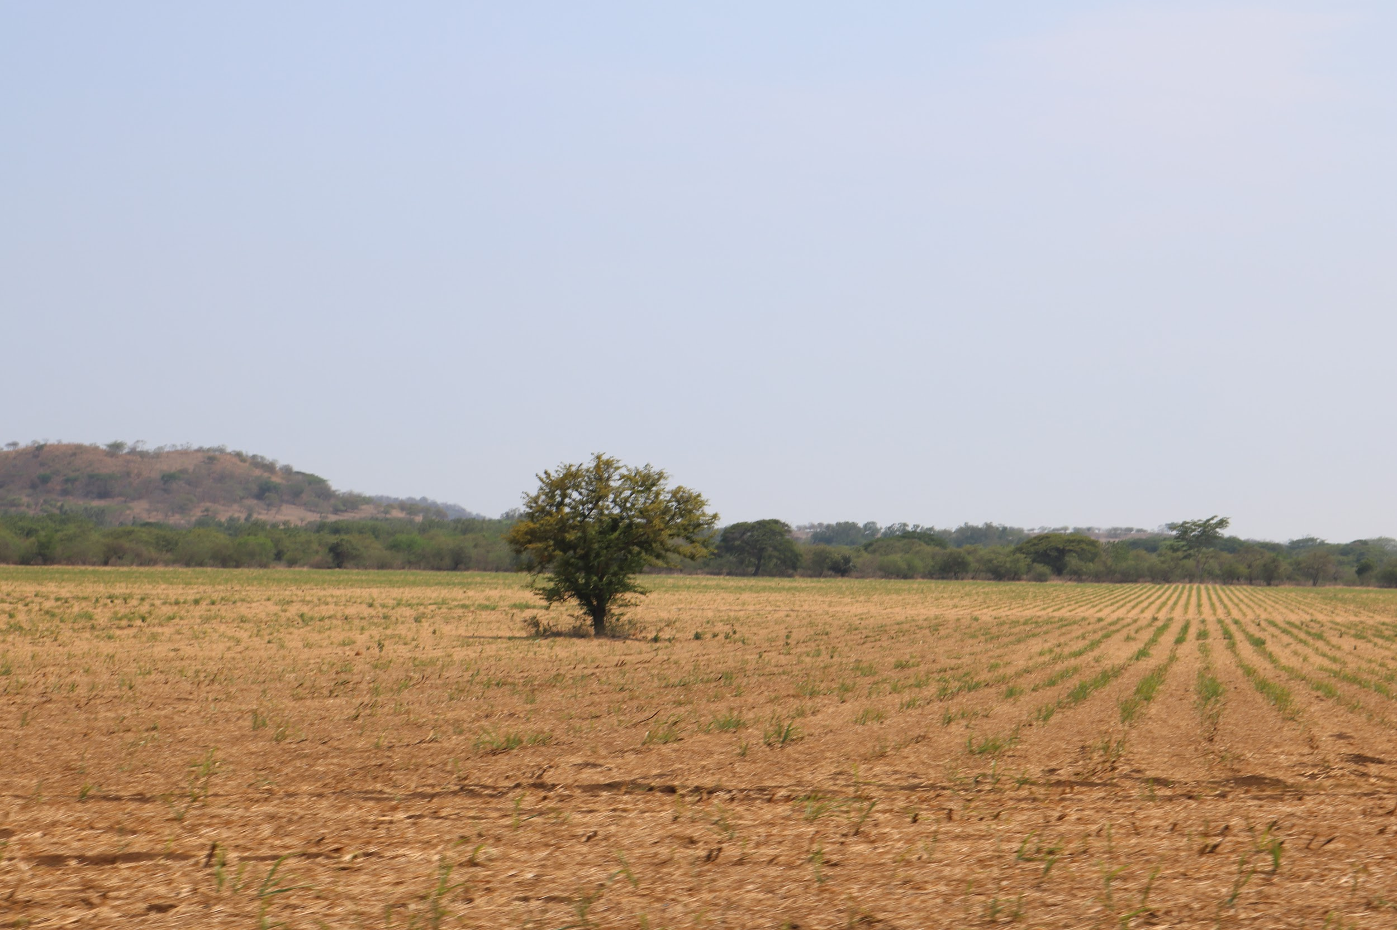
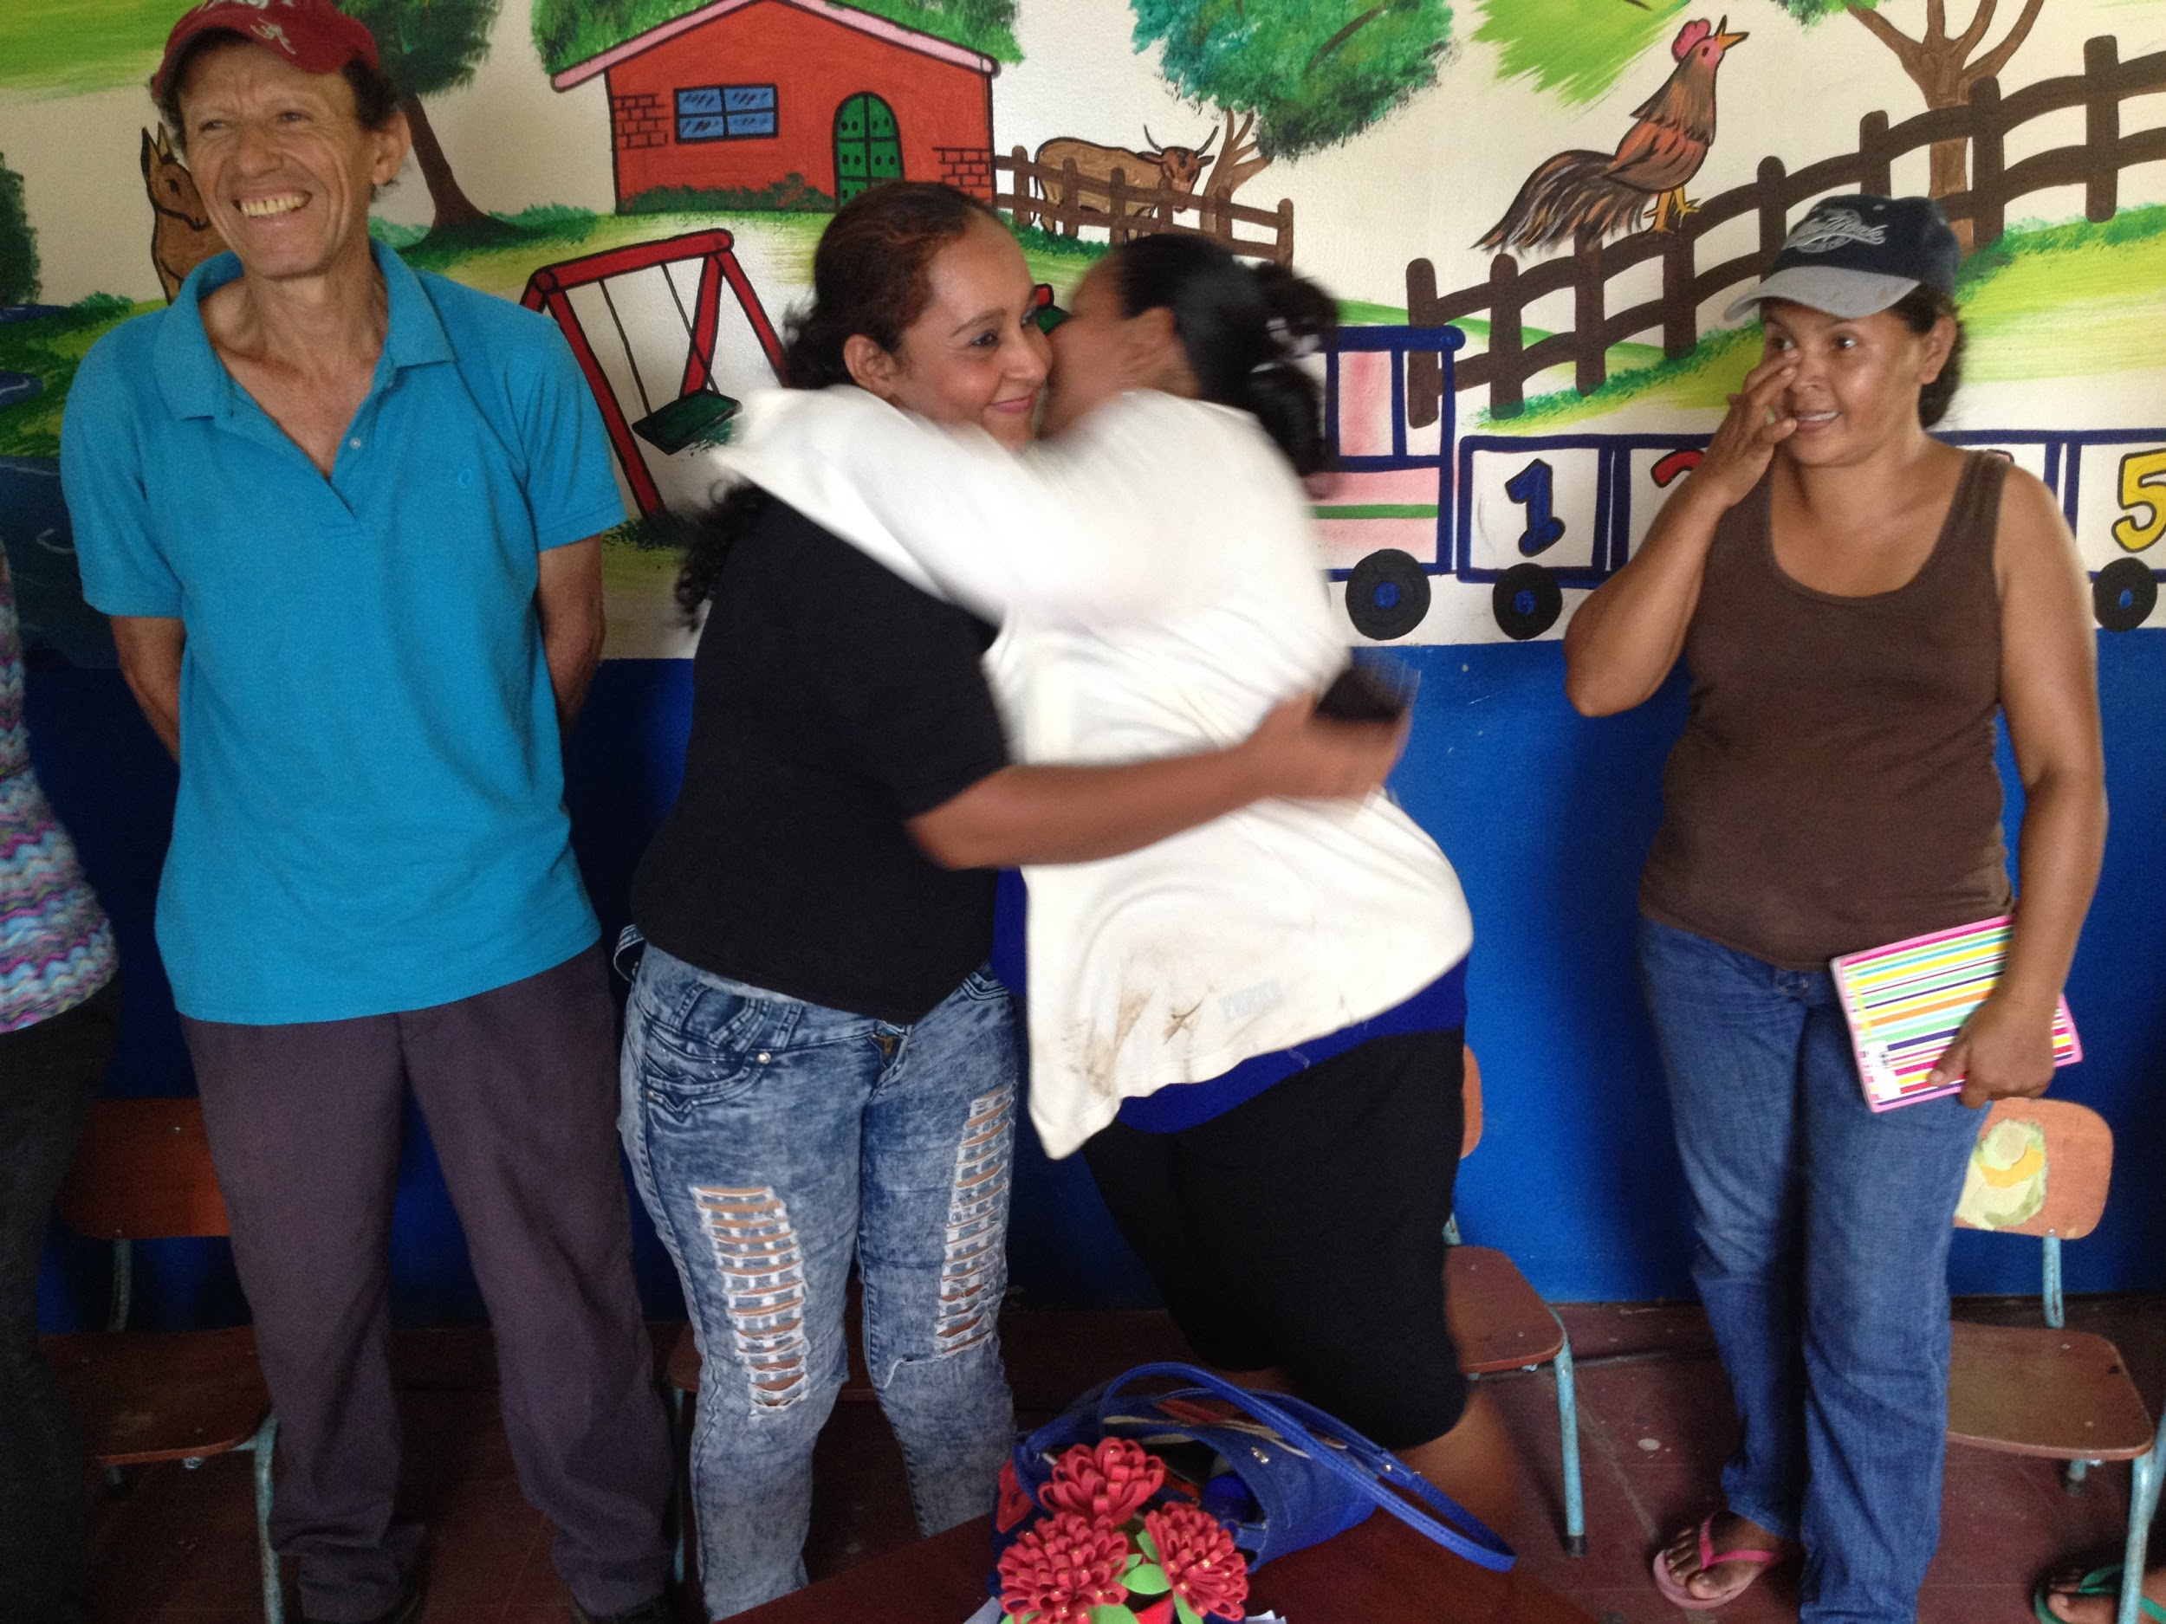
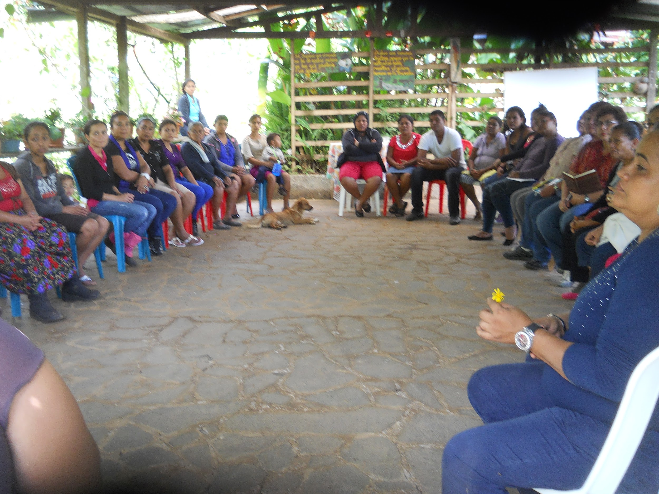
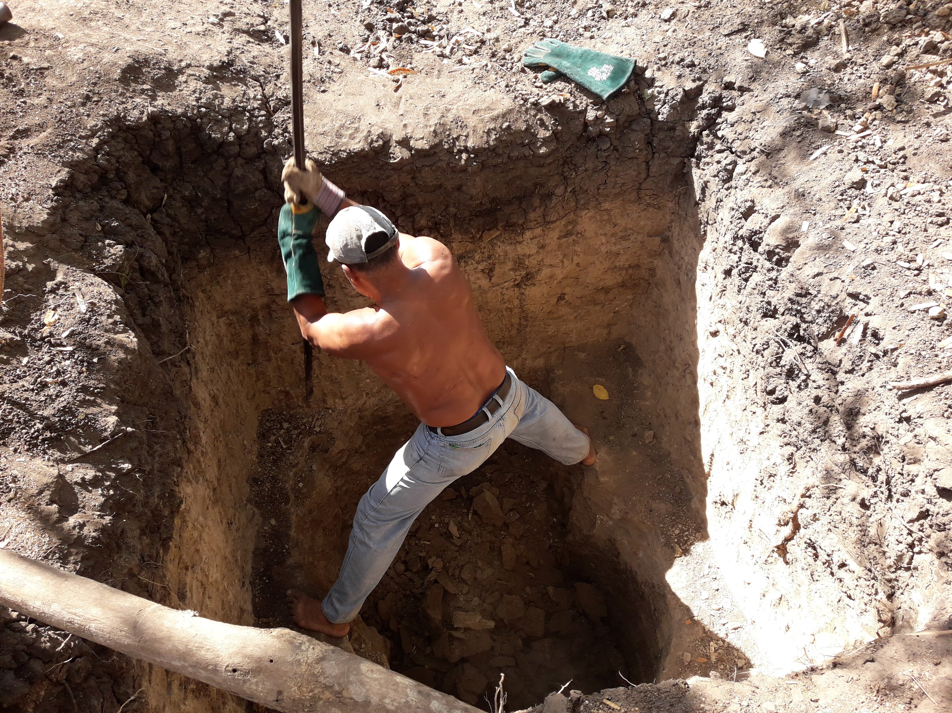
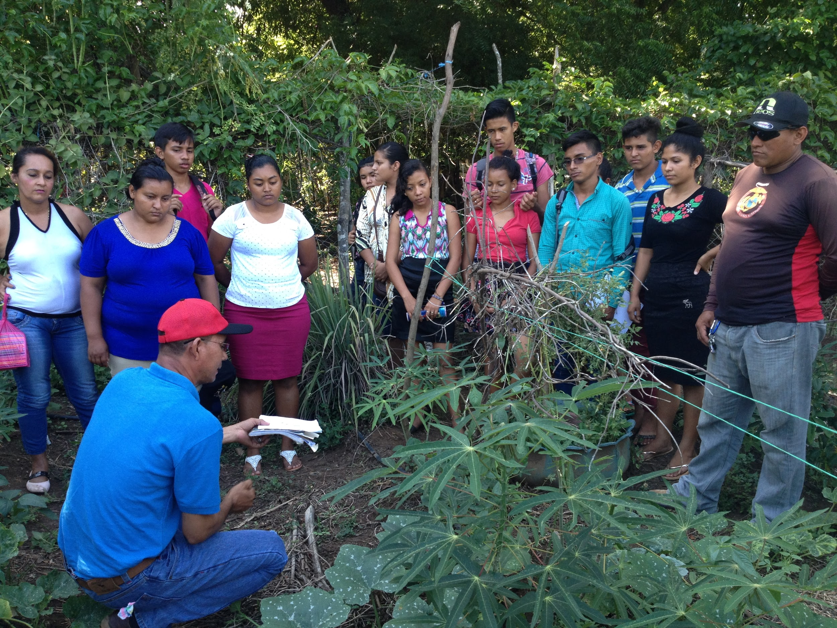
Human Capacity Training (HCT)
> Our program begins with socio-emotional resilience training, community organizing and leadership building. After this phase, individuals move on to workshops covering environmental education and stewardship.
Environmental Education & Stewardship Goal:
> Empower the community with the knowledge to leverage their local resources. Teach community members about caring for the environment so they can care for their community on their own.
> After completing the environmental training phase, individuals move onto the application of their new skills in our Family Farming Project.

Slide 8
Family Farming Project
The Issues:
> Despite living on fertile land, most residents have lost the knowledge to farm the land.
> Individuals tell us (VL) that they don’t have “enough” land to farm properly.
> Individuals use chemical based agricultural products that harm the land.
> Negative externalities (soil contamination, agricultural runoff, aquifer depletion) from surrounding agro-business (sugarcane, cotton).
Our Program: Trains individuals in farming, stabilizes family life and leads to better overall outcomes; families live in an improved and healthy environment, families no longer need to worry about immediate food needs and can focus on building a different future, children no longer need to pick crops which delays and/or limits their education, families have better health outcomes from better diets, and families develop new economic opportunities.

Slide 9
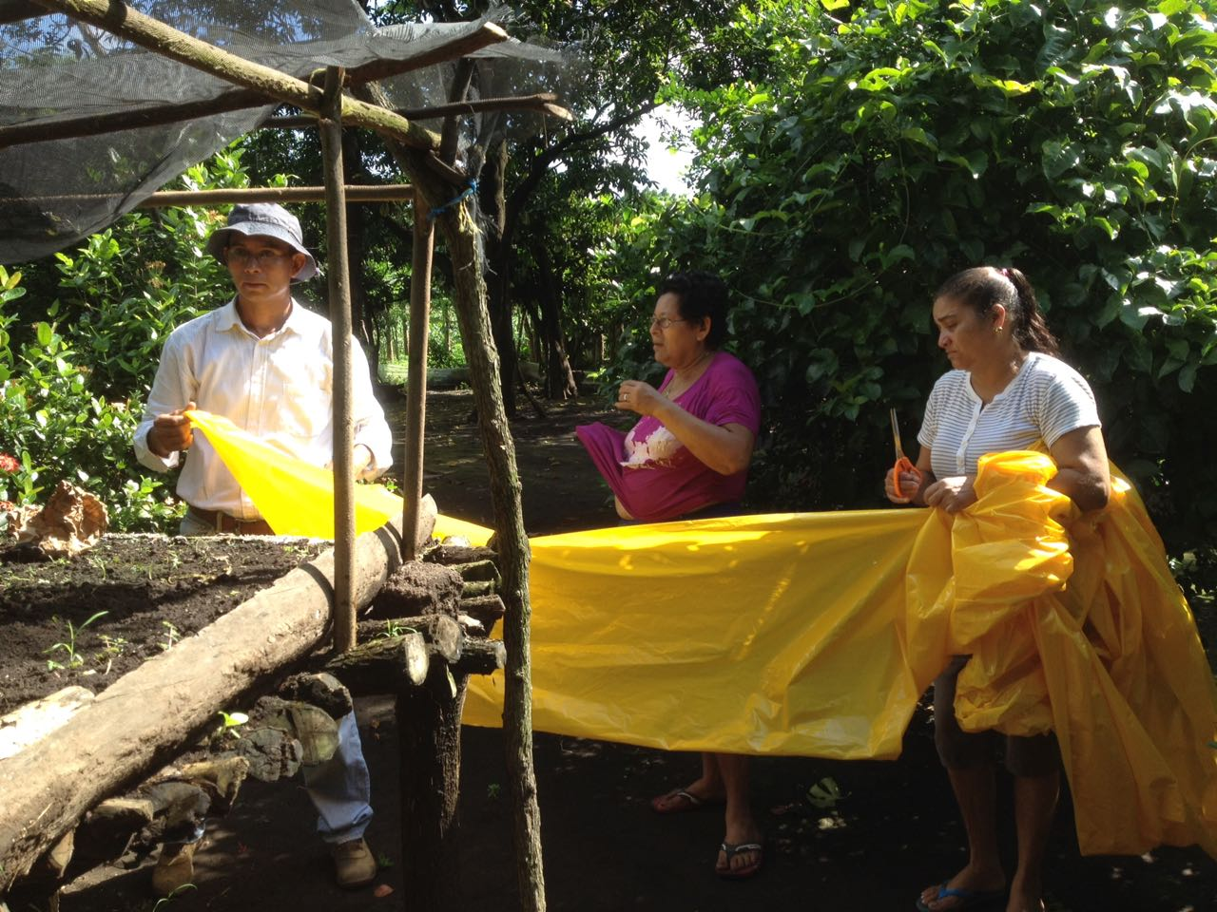
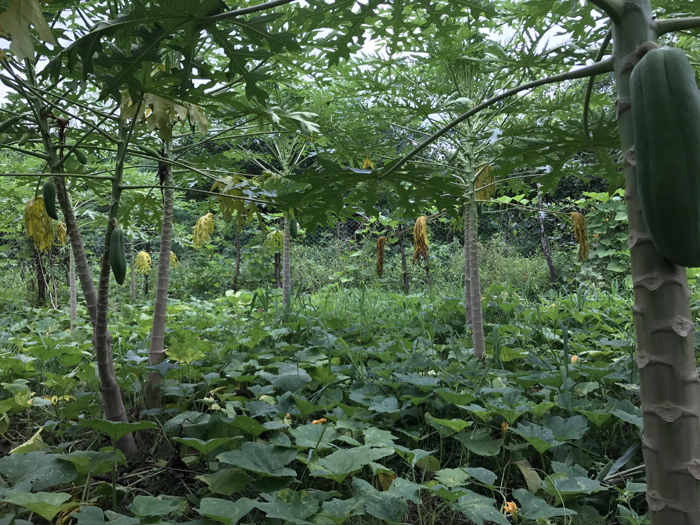
Family Farming Project, Training Overview
Plant Science
Soil Nutrient Management
Nursery Construction + Plant Care (Germination)
Farm Construction + Transplantation
Micro-climate Creation
Organic Pest/Disease Management
Water Management
Crop Diversification, Polyculture farming & Crop Sequencing
Managing Agricultural Debris
Weekly Technical Supervisions, Climate Adaptive Agricultural Planning & Expansion

Slide 10
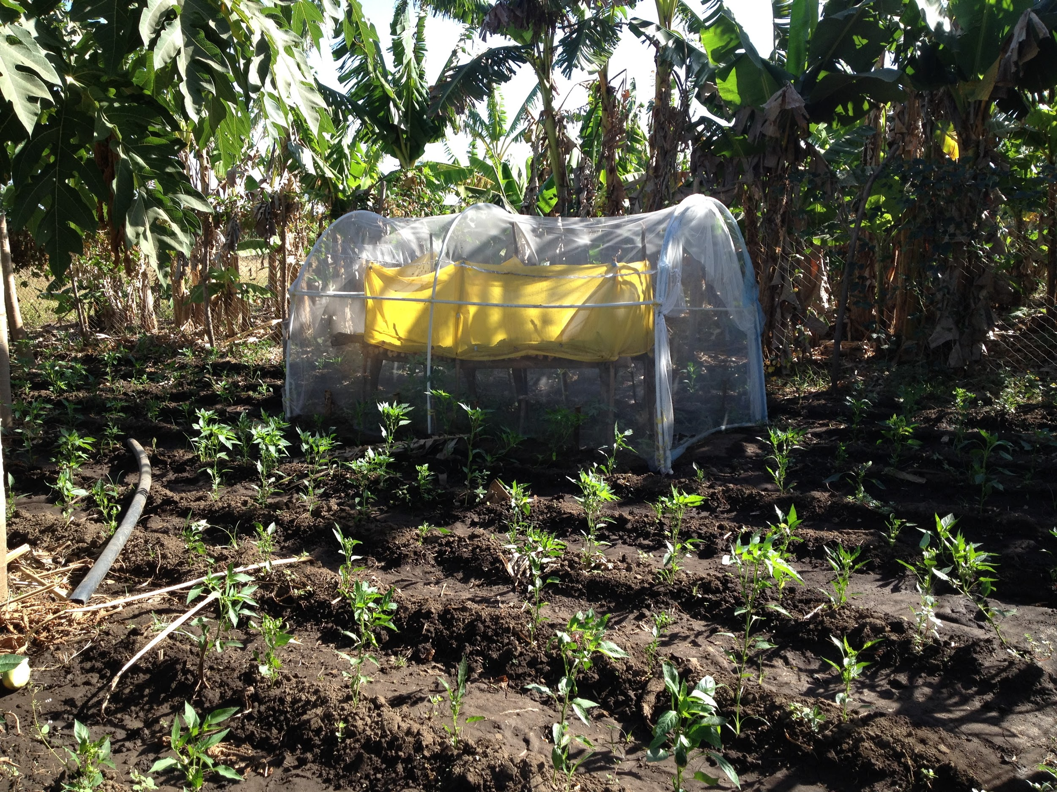
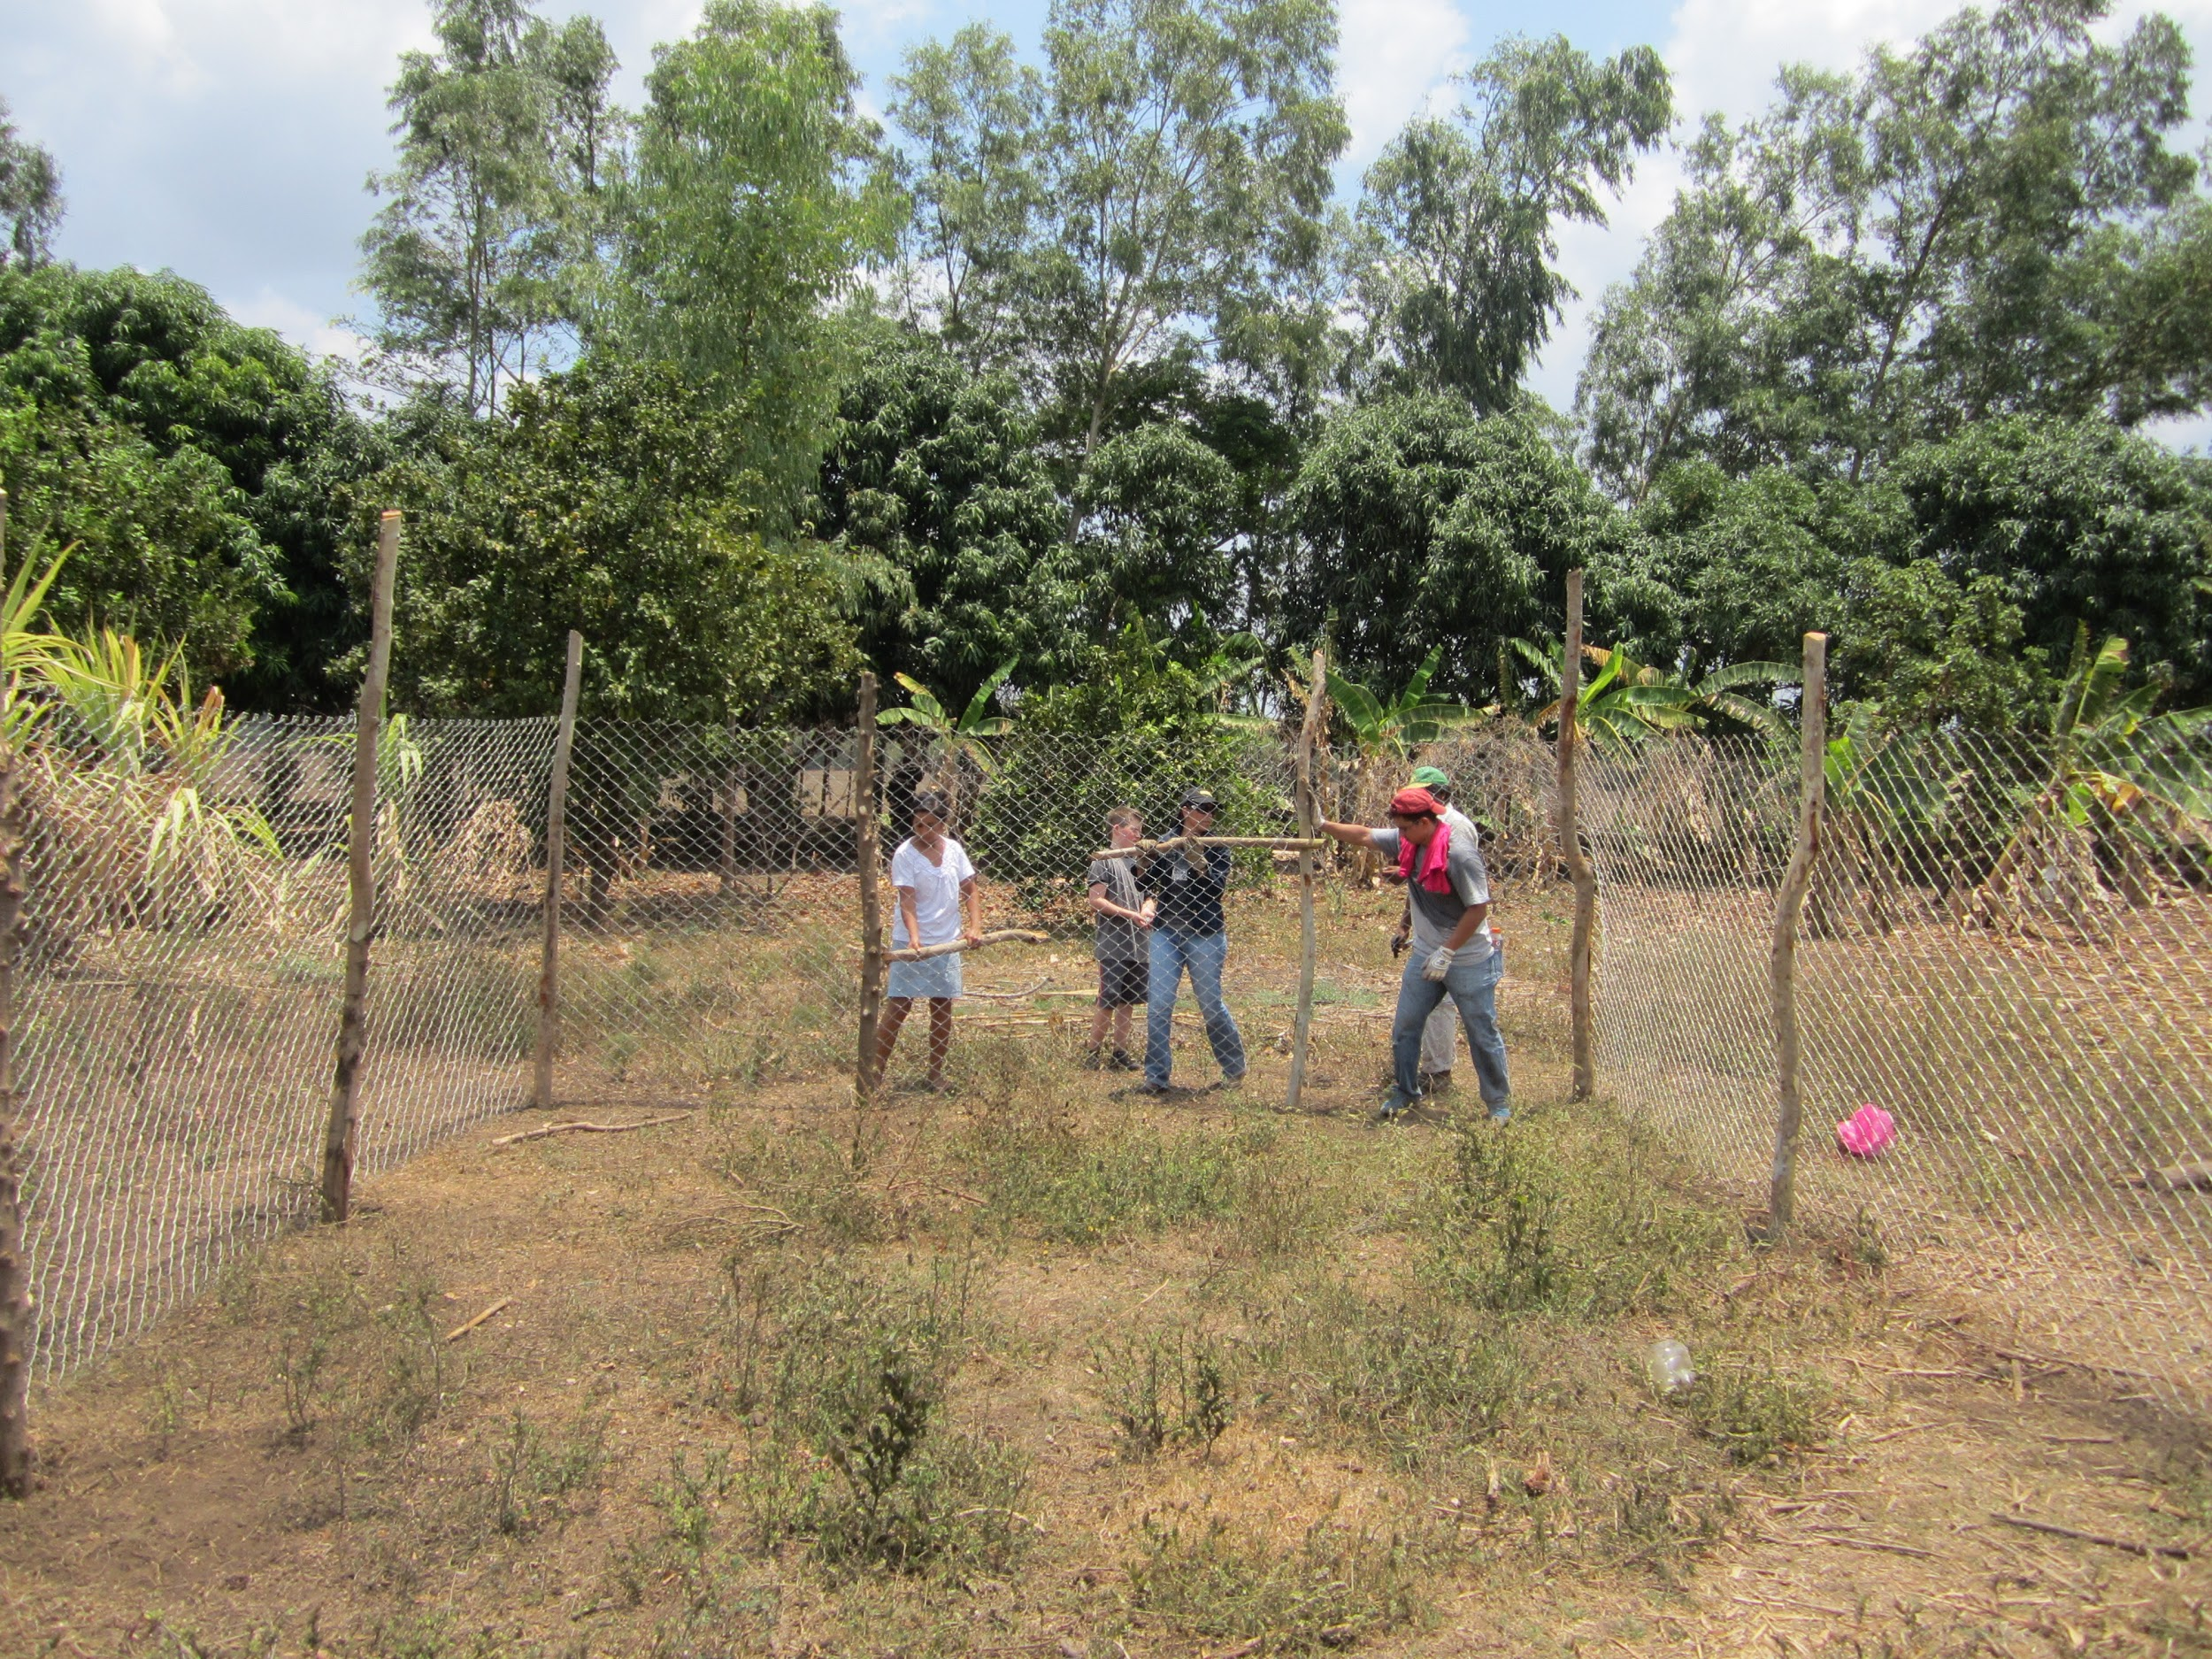
Our Trainings (1-4)
1. Plant Science: train individuals regarding stages of plant development, and interventions one can take to support positive plant development.
2. Soil Nutrient Management: train individuals in compost and fertilizer creation. Using cow manure, sand and crop debris, individuals go through a system of layering and mixing. This mixture is used to prepare the land, improve soil nutrient levels and retain soil humidity.
3. Nursery Construction + Plant Care: trains individuals to create both ground based and elevated protected nurseries. Covered nurseries creates a high humidity environment to support seed germination. Individuals plant the seeds and care for them over 25-30 days before transplantation.
4. Farm Construction + Transplantation: we provide individuals with the resources to construct their farm: wooden posts, chain link fencing protects the farm from animals as well as a structure for crops to grow (green beans). Farms are 15x15 meters (49.2x49.2 ft). Once completed, individuals transplant mature seedlings and harvest can occur 2.5-3 months after transplantation.

Slide 11
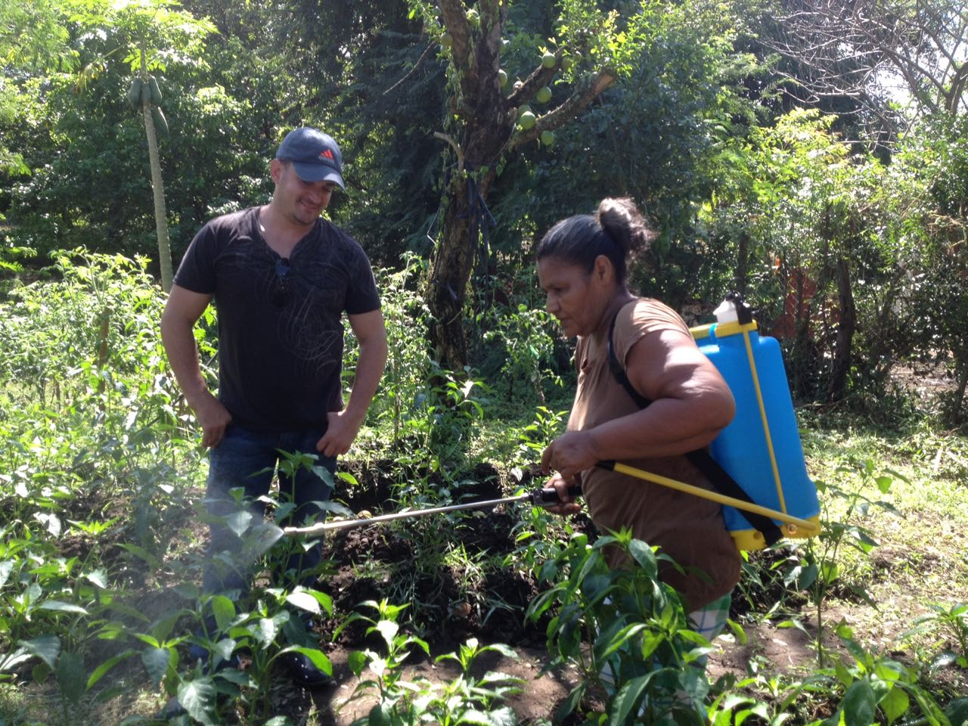
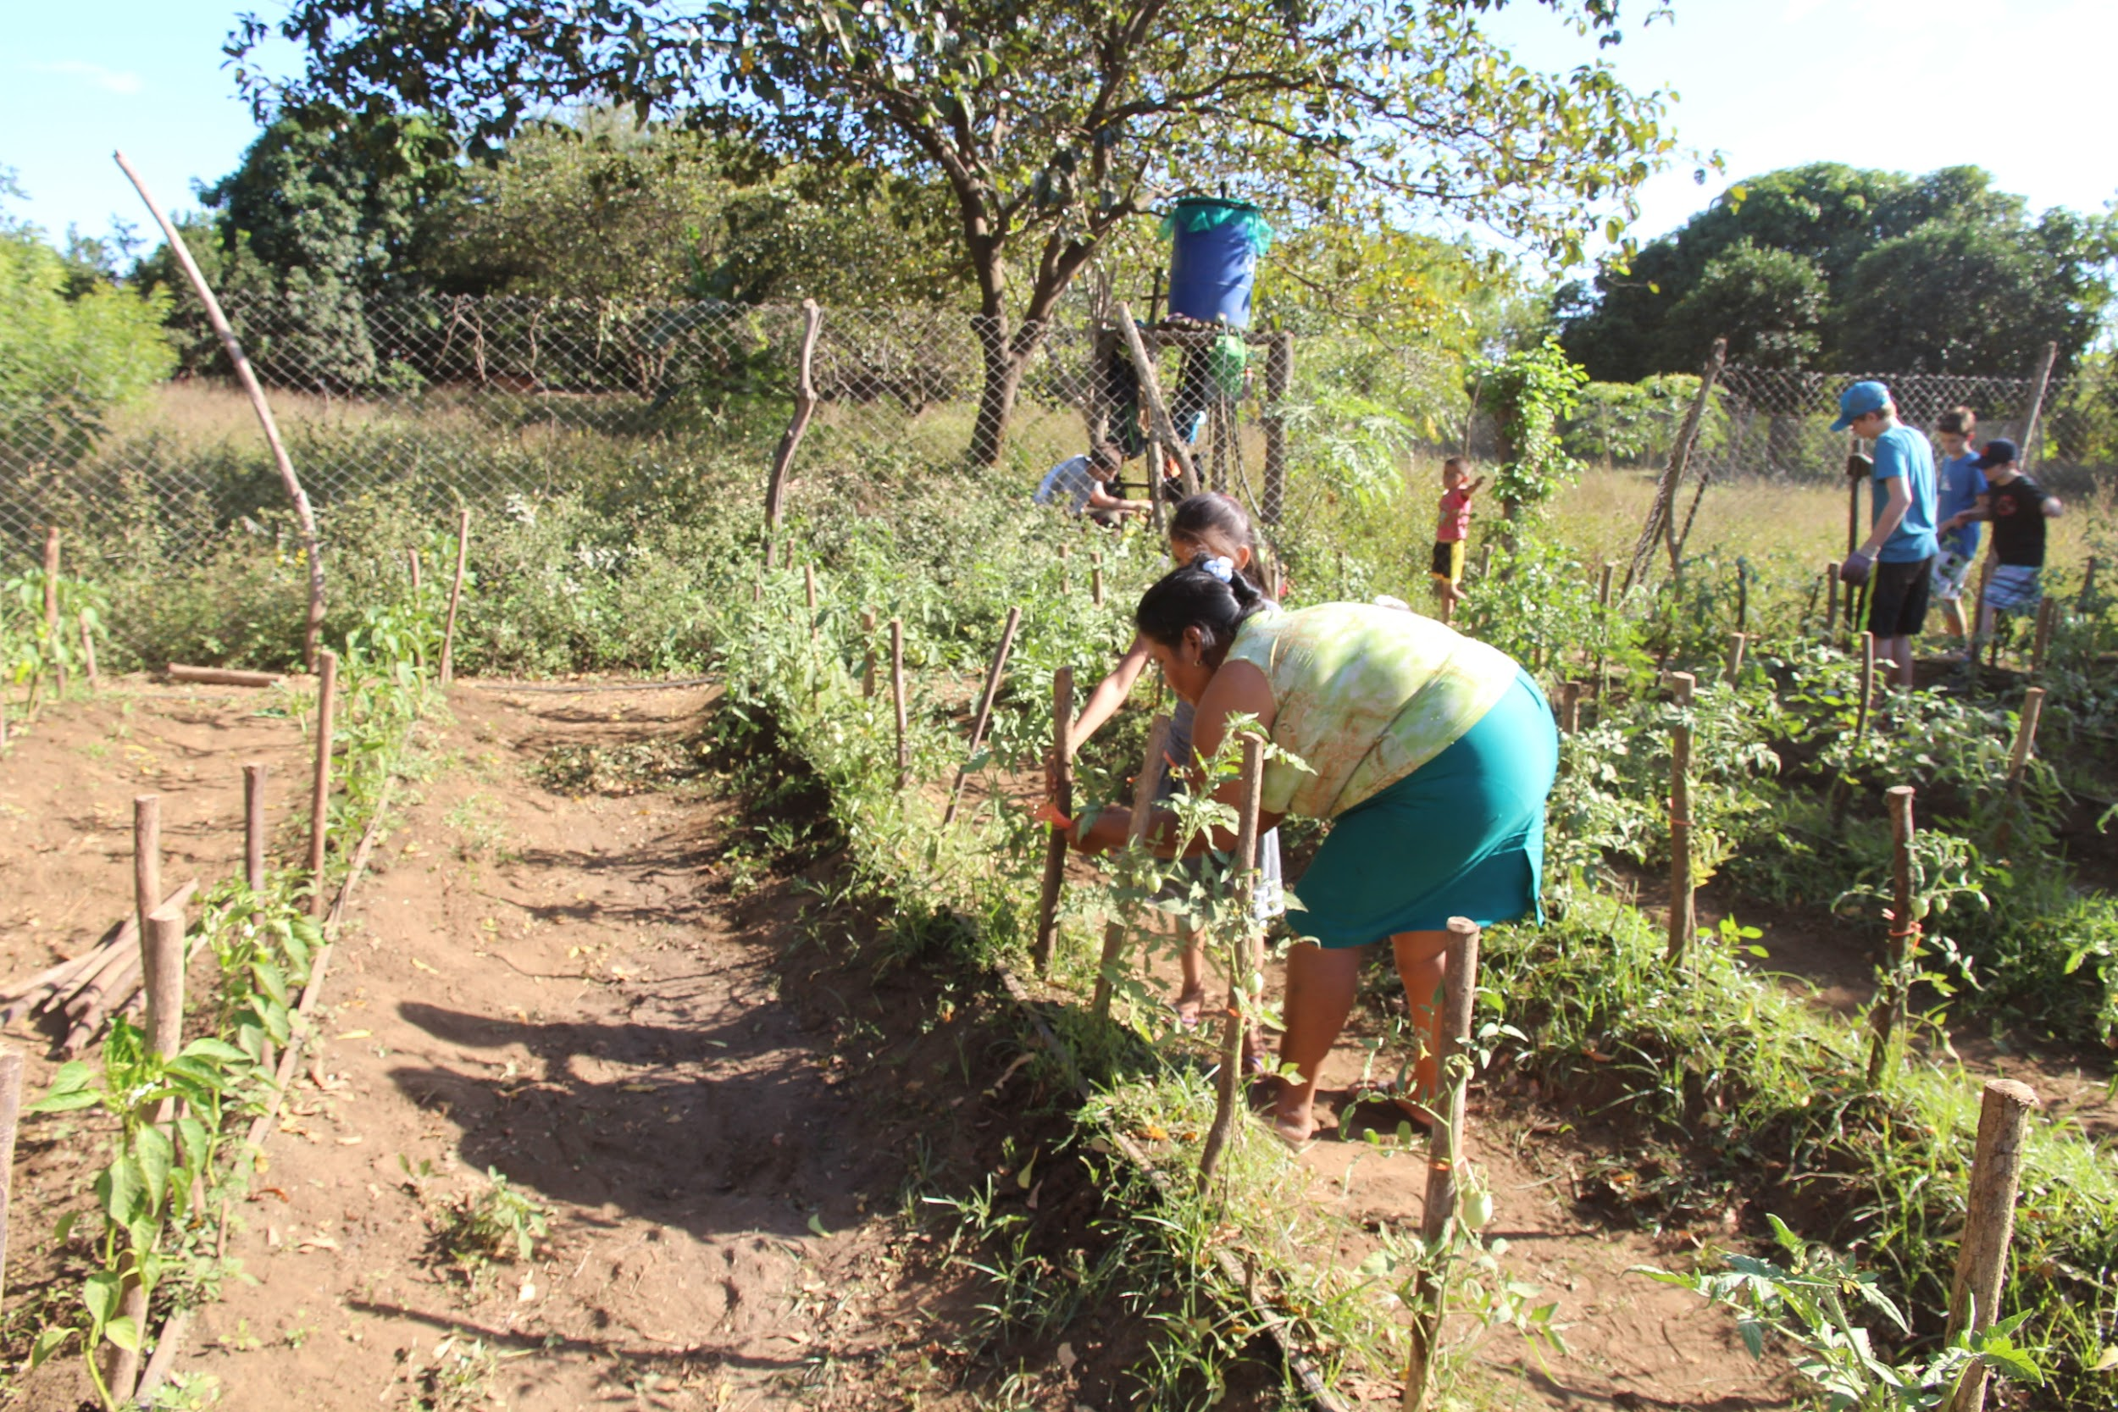
Our Trainings (5-7)
5. Microclimate Creation: train individuals in methods to create microclimates to address hot Nicaraguan weather that strips soil moisture and harms plant health. We plant papaya trees, the shade creates a microclimate (10-15 degrees cooler), helping the retain moisture, a high humidity environment, and protects the farm.
6. Organic Pest/Disease Management: train individuals in ways to create their own pest/disease management products. Methods: Liquified 1 head of garlic and onion mixed with 1 ltr of water (pest); Liquified 1 lb of chile with 1 ltr of water (pest); Shredded neem leaf mixed with water (pest); Ashes applied to base of the plant (fungus). Organic products can be applied every 2-3 days and it won’t contaminate the land.
7. Water Management: trains individuals on the importance and the construction of drip irrigation systems. This irrigation system is supported by family wells, this method prevents weeds from growing and allows for water to be targeted at the base of the plant. Current water issues tied to irregular rainfall and depleting aquifer levels due to surrounding agrobusiness (sugarcane). Well Improvement Project was created to deepen wells, construct new wells, and promote water conservation.

Slide 12
Our Trainings (8-10)
8. Crop Diversification: train individuals on the importance of polyculture farming, crop diversification and sequencing. Community only cultivated crops tied to diet (Ayote/Squash, Pipian/Gourd, Corn, and Peanuts). Diversification leads to better nutrition and improved diet. New crops were introduced (Tomato, Chiltoma/Sweet Pepper, Cucumber, Green Bean, Banana, Carrot, Radish, Green Onion, Watermelon, Melon, and Papaya). 5-6 varieties of crops are cultivated, 3 harvests a year. Crop rotations align with our 2 rounds of seed disbursements. 2-3 seed varieties are given during each disbursement (tomato, chiltoma/sweet pepper, cucumber, and green beans).
9. Managing Agricultural Debris: train individuals to manage debris, promote hands on approach. Use debris for compost/fertilizer, we do not recommend lighting the debris on fire or using machetes since it may cause damage to the irrigation system.
10. Weekly Technical Supervisions, Climate Adaptive Agricultural Planning & Expansion: VL’s agricultural coordinator and farm technician visit farms on a weekly basis, track crop development, provide recommendations, reinforce farming capacities, retrain individuals and create tailored plans with each farm. Promote farm expansion to increase crop production, create surplus and open up economic opportunities.

Slide 13
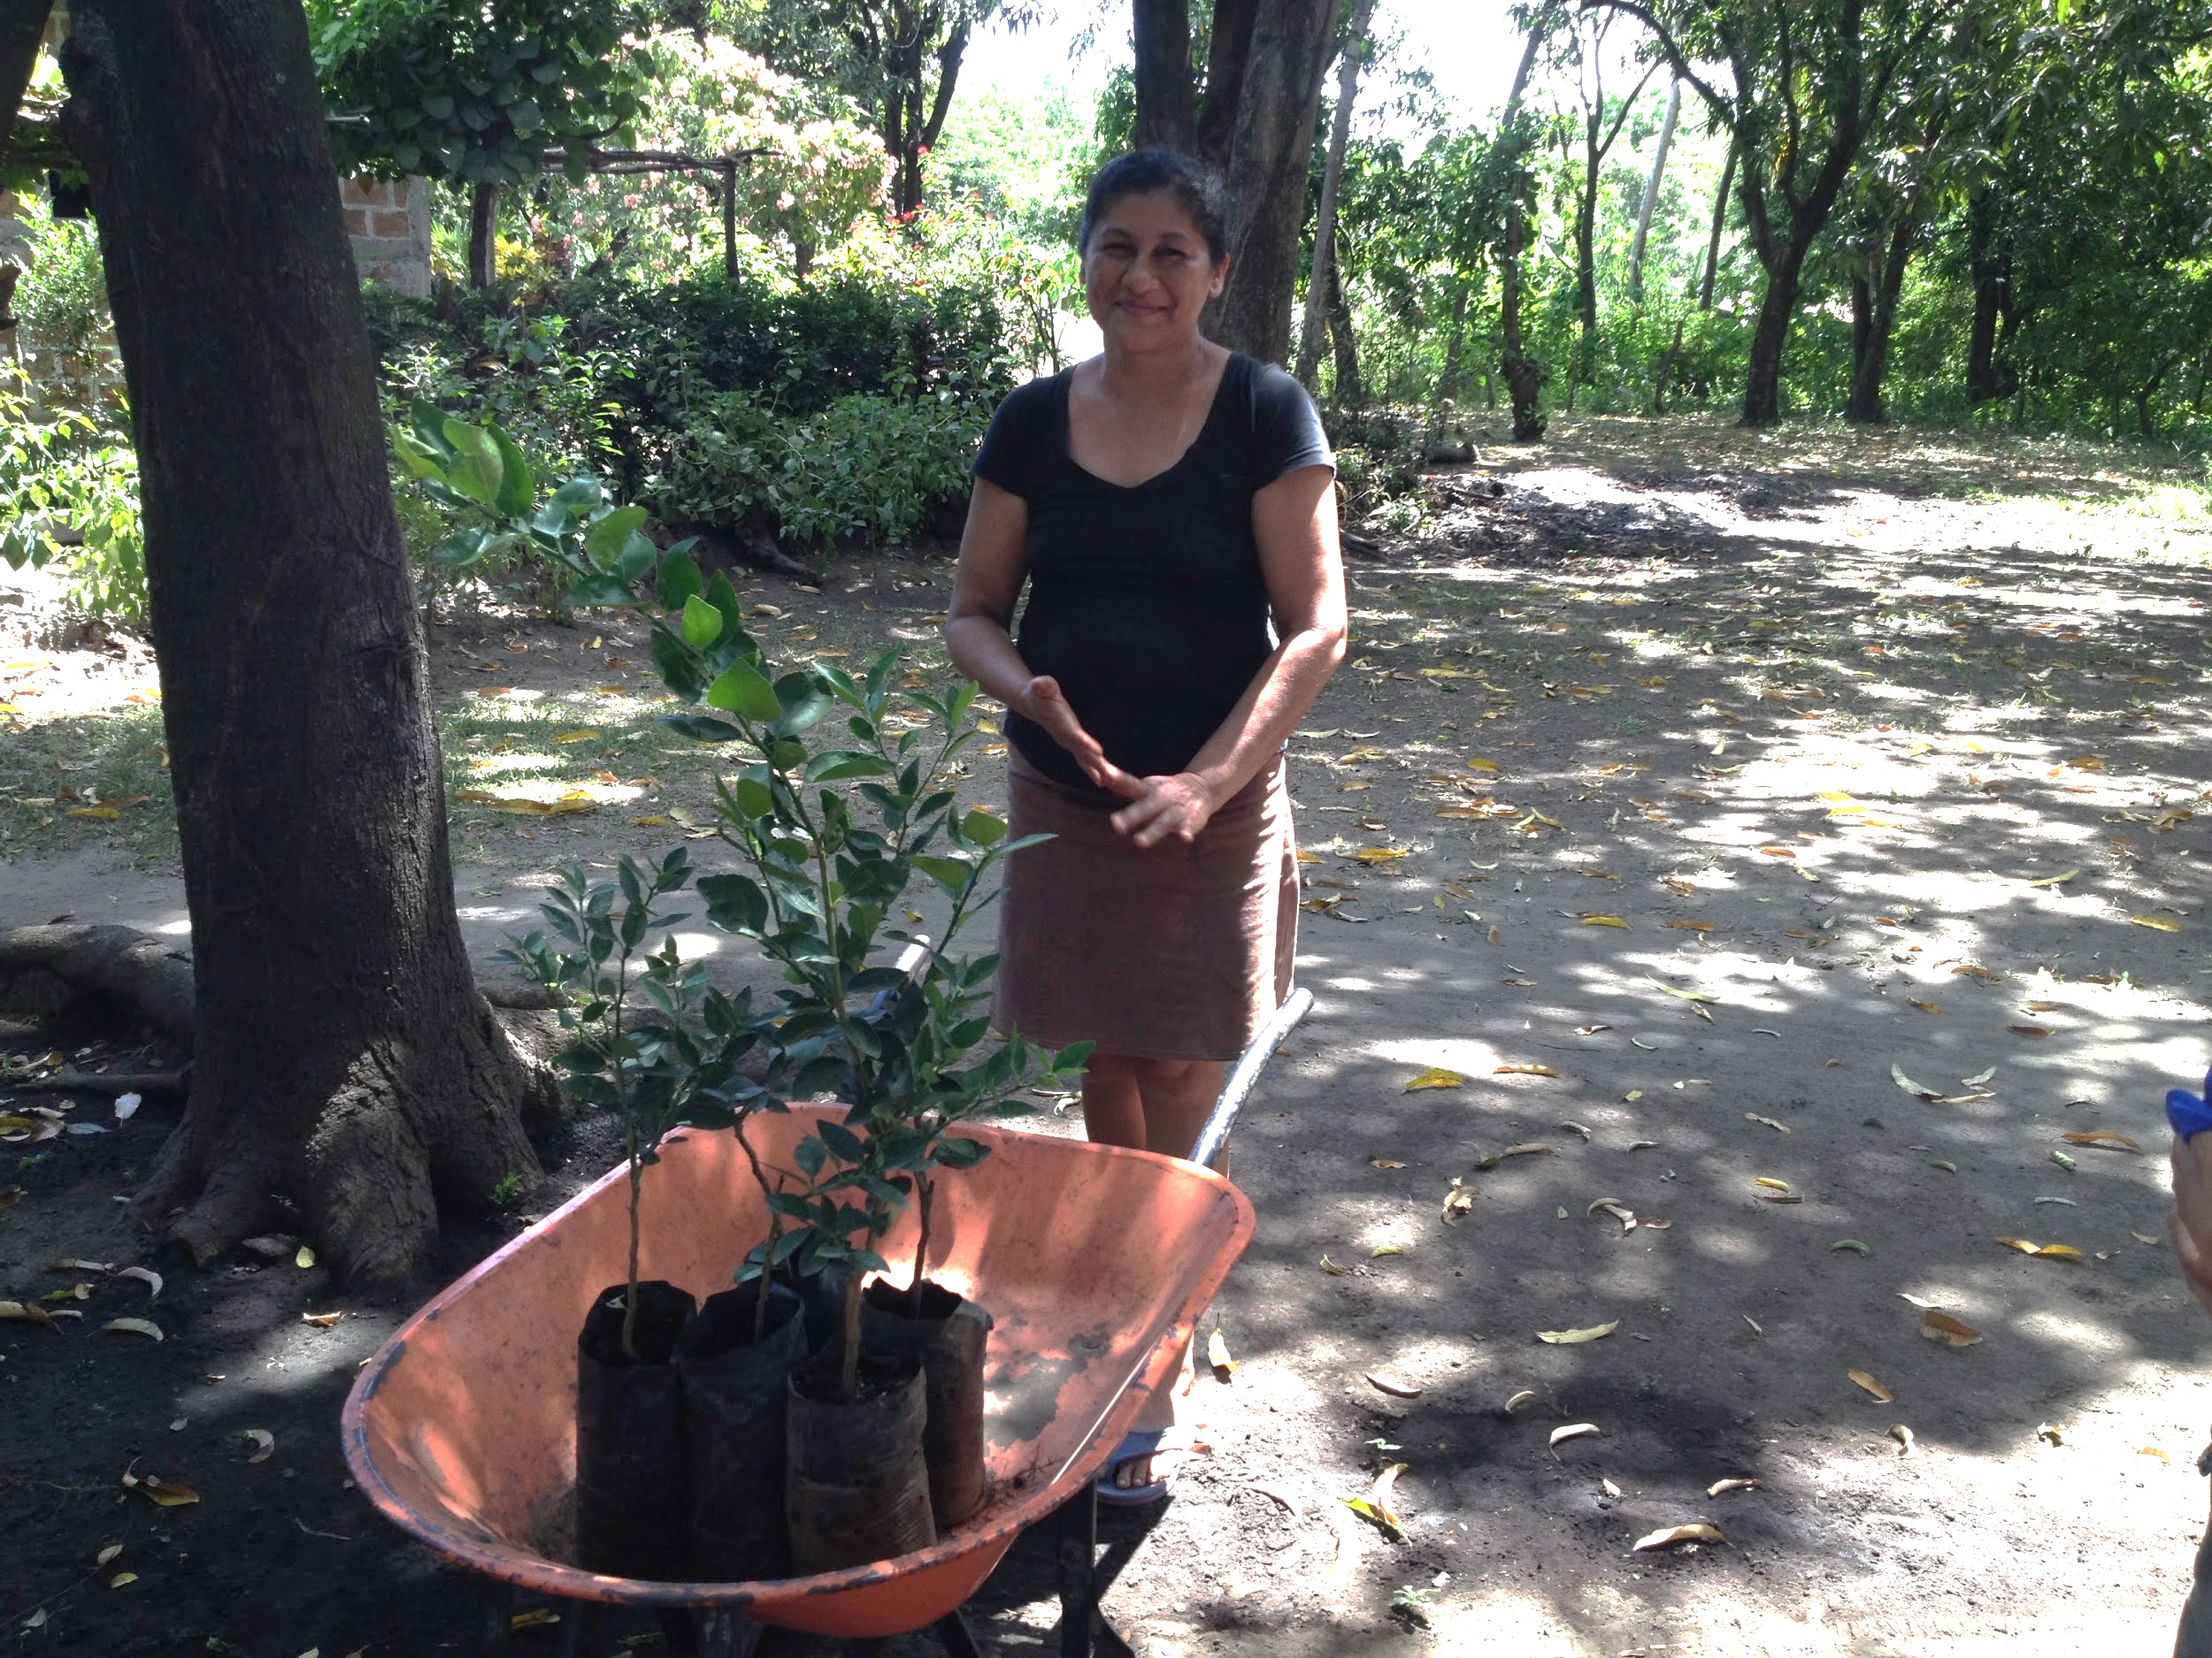
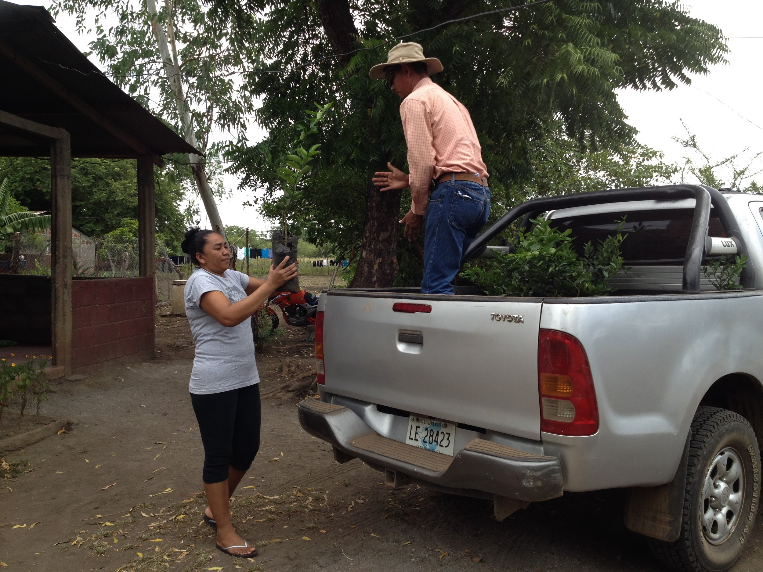
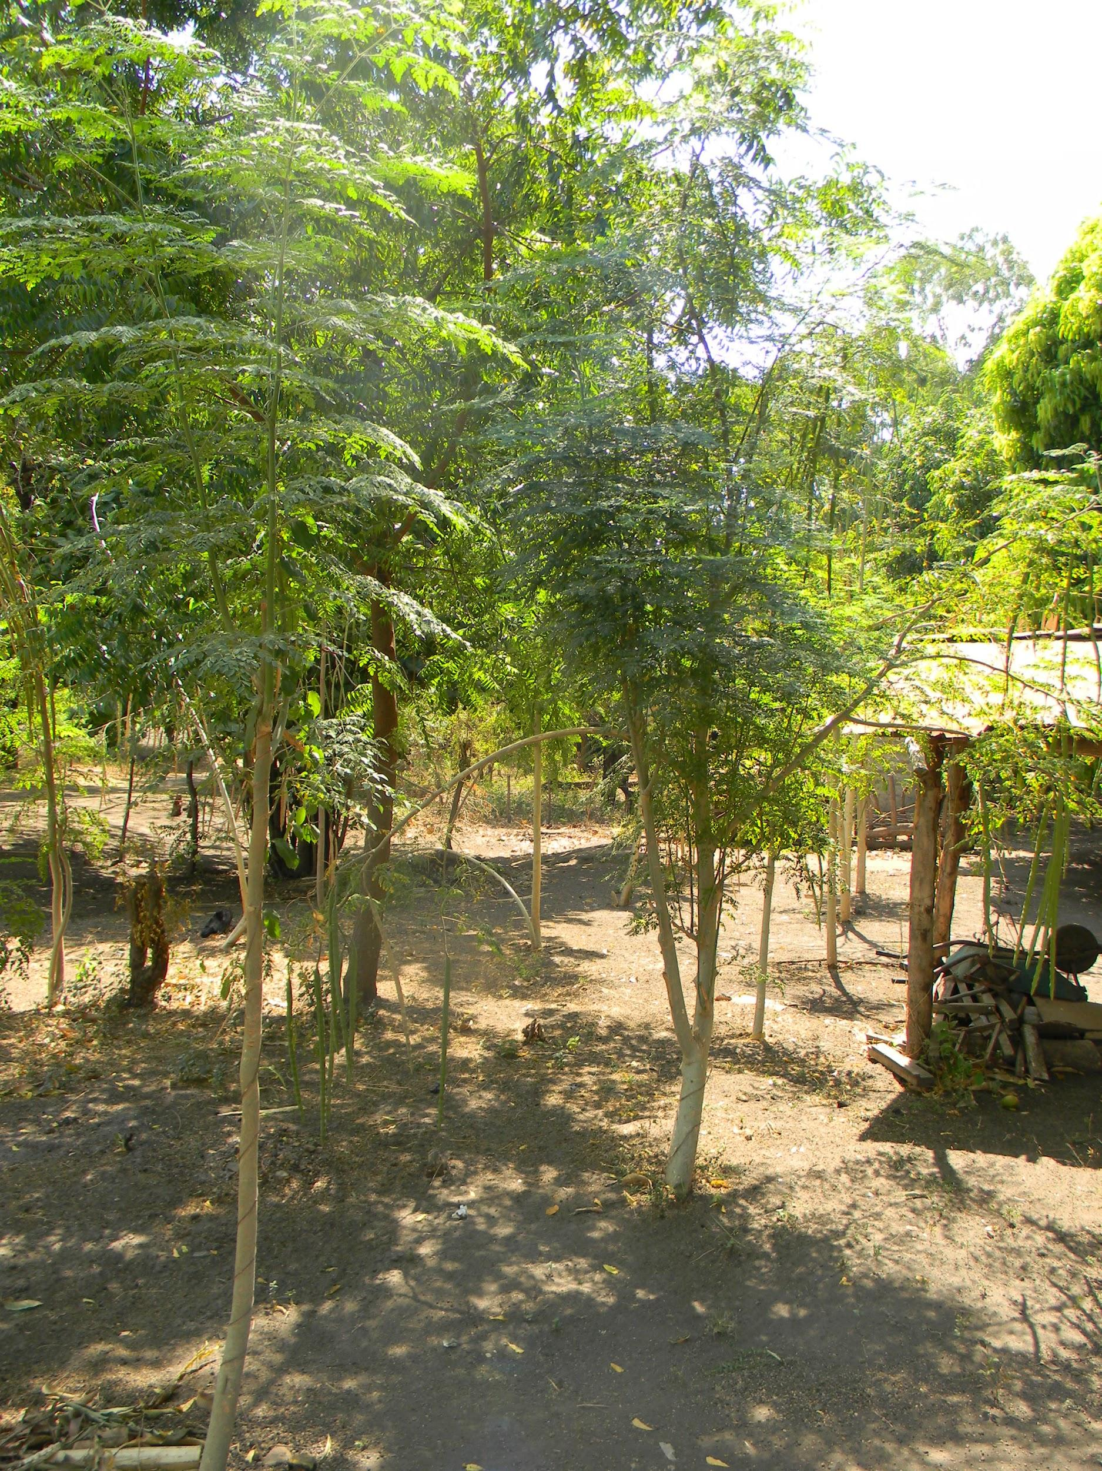
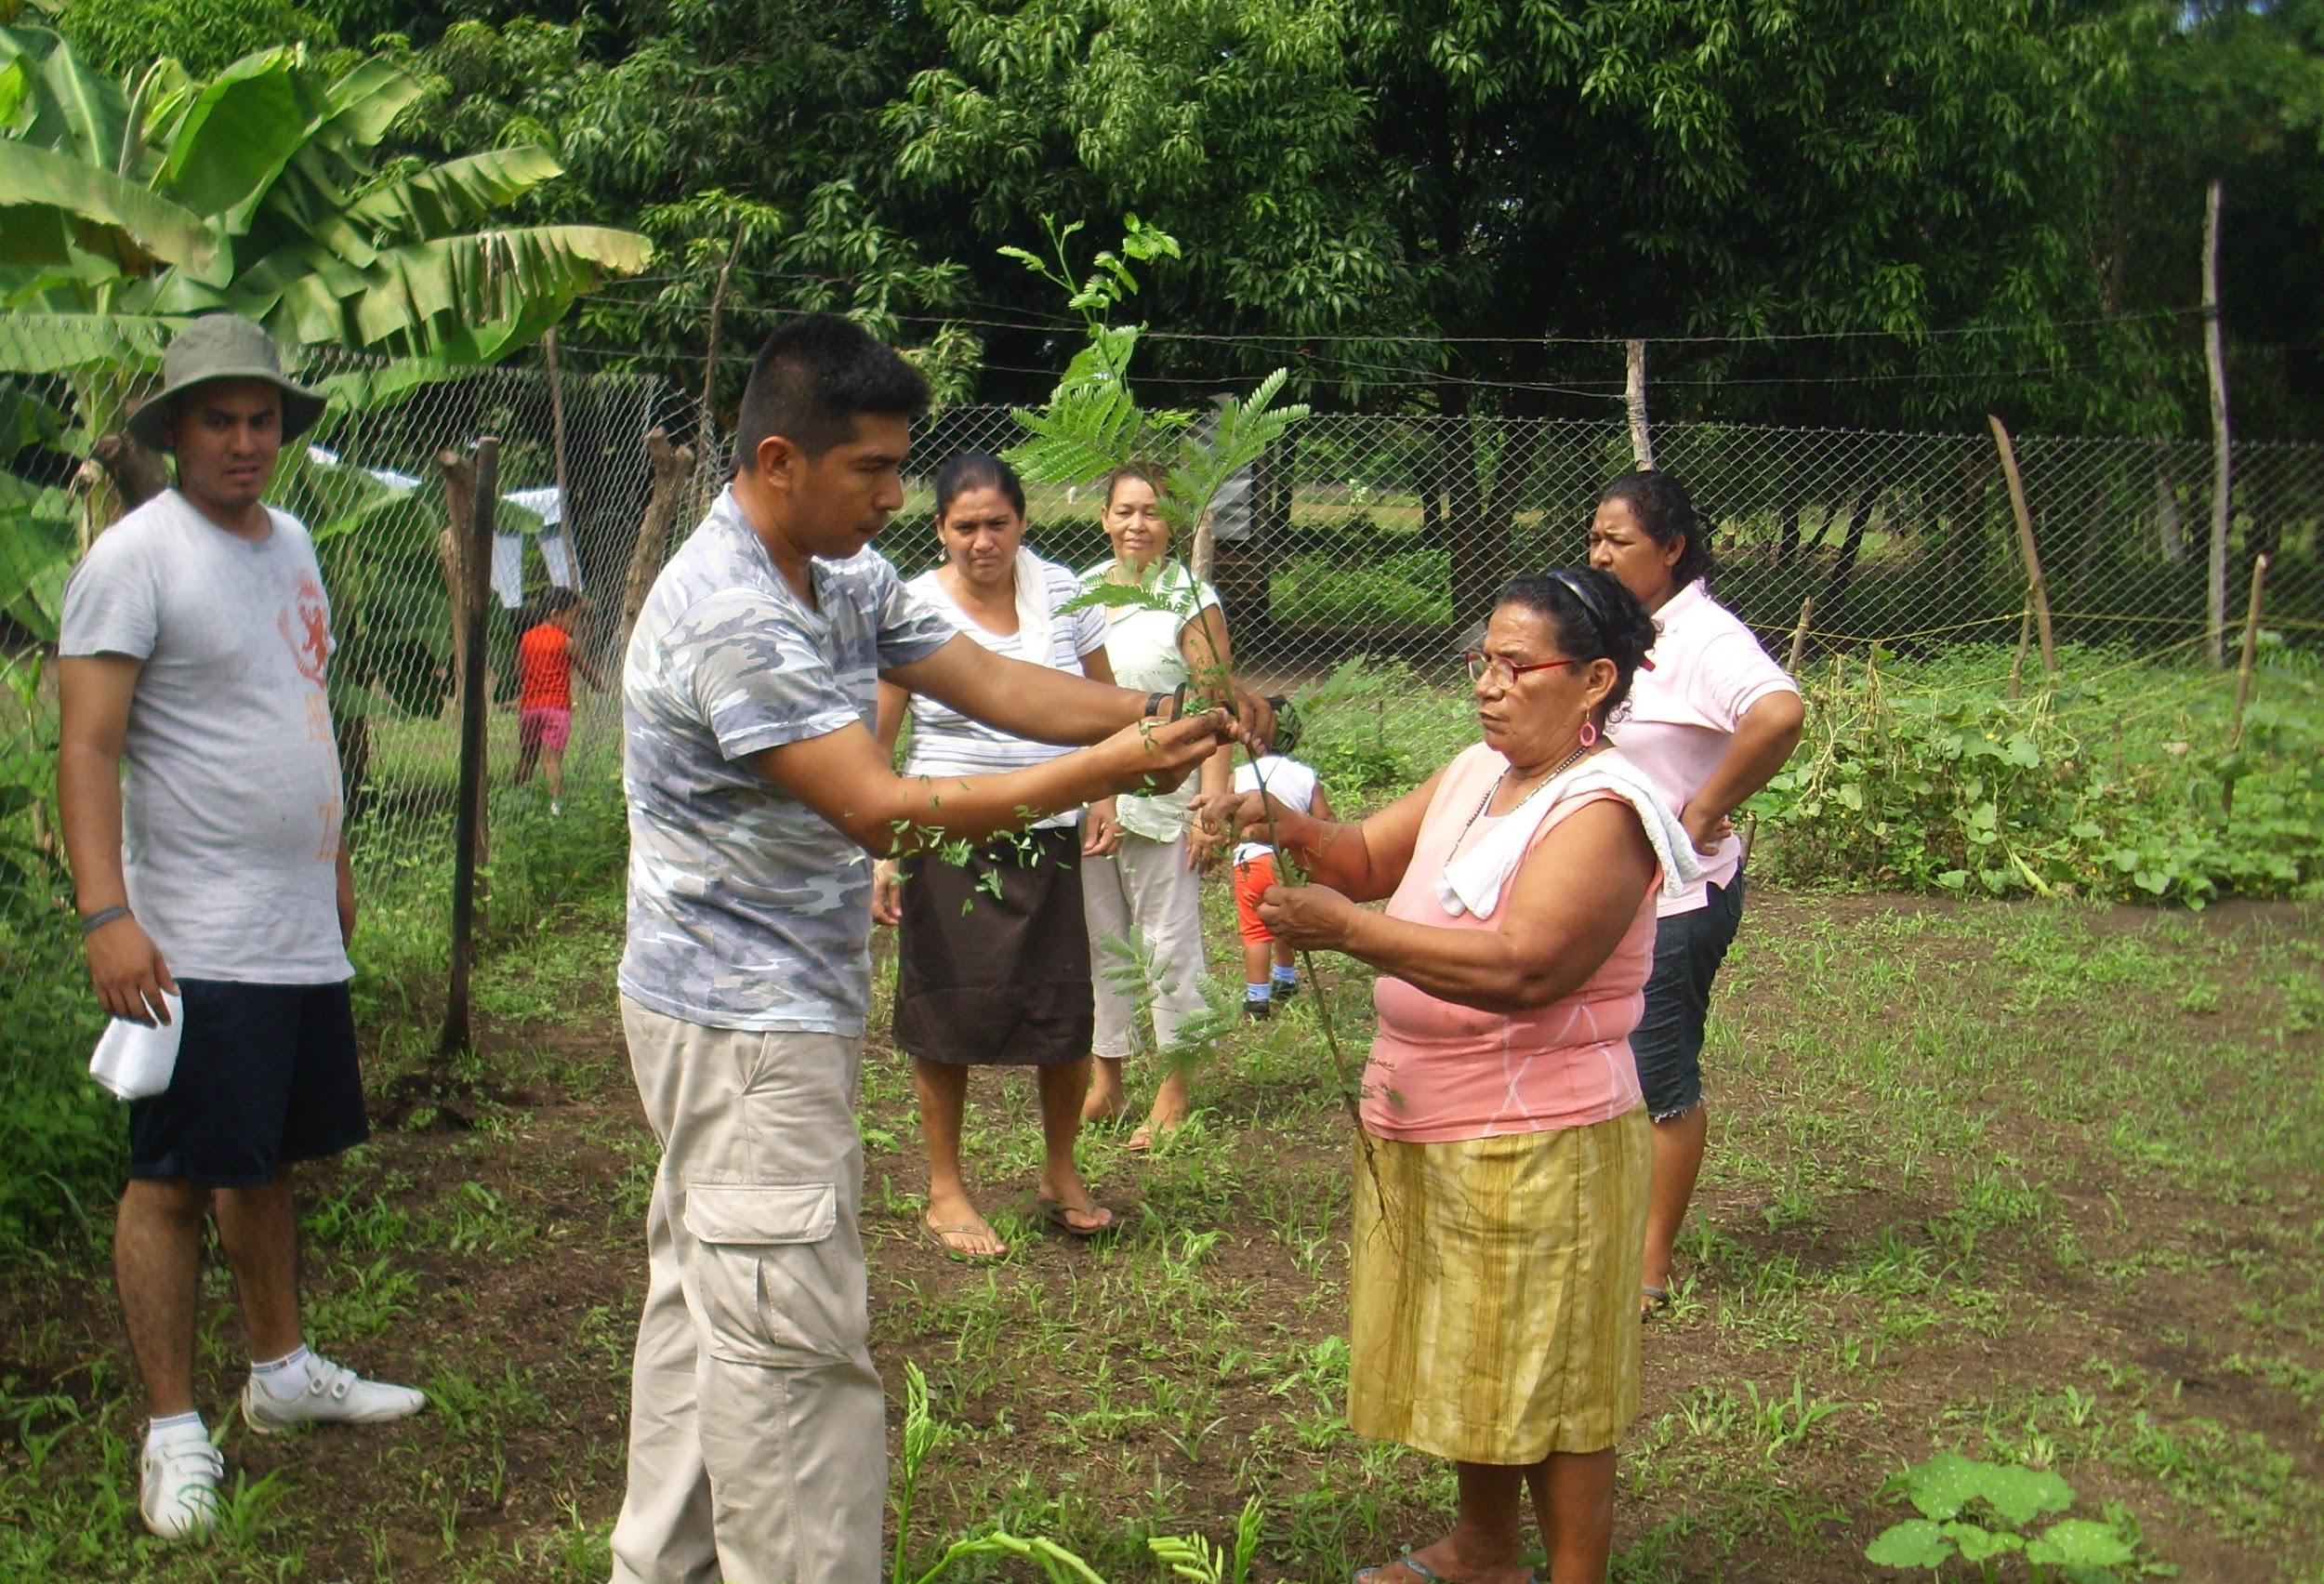
Reforestation Project
Goal: train individuals to restore farmland and watershed through the reforestation of native trees, tied with environmental training.
> Realities: Individuals have internalized the conceptual piece: plant science and the environment; however as a practical project they have not been as enthusiastic in forest restoration in comparison to planting trees for food production.
> Reforestation Shift: individuals didn’t see immediate benefits from reforesting firewood trees so we shifted to fruit trees. This shift significantly increased reforestation success and tree survival rate. Families were excited to have fruit trees on their properties.
> Fruit Trees: individuals were given Lemon, Mandarin, Avocado, Guava, and Mango trees.

Slide 14
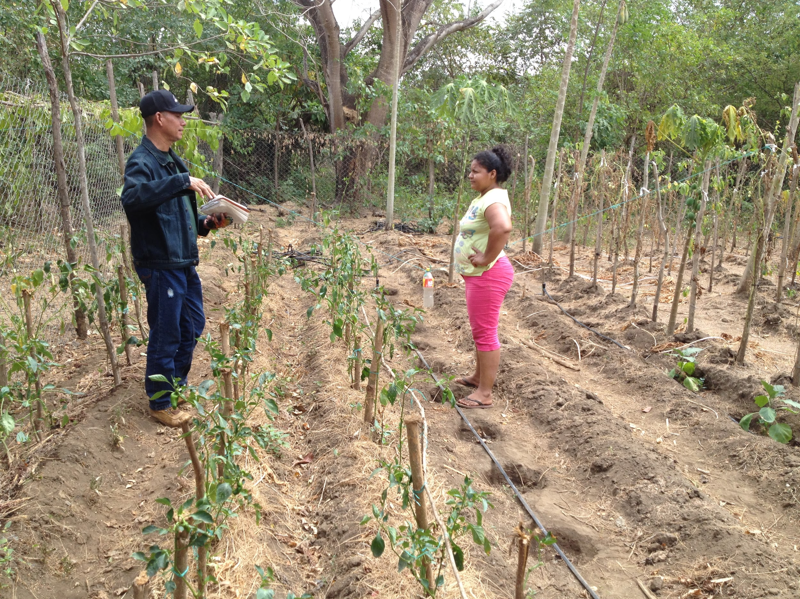
Strategies for Success
How does our program work over time to be successful?
Weekly Technical Supervisions:
Consistent and targeted agricultural recommendations to support crop production.
Allows for Family Farming Program evaluation through data collection and beneficiary testimony.
Build and reinforce individual farmers’ capacities through various agricultural methods.
Keep farmers motivated.
Promote a healthy diet through crop diversification.
Promote farm expansion to increase crop production and open-up new economic opportunities.
“Being present is ViviendasLeón’s greatest asset. Families see that we are invested in their success for the long-term.”
- Lesbia Alvarado
Weekly visits by our technical consultant, Camilo Mendez and interviews with our program director, Lesbia Alvarado.

Slide 15
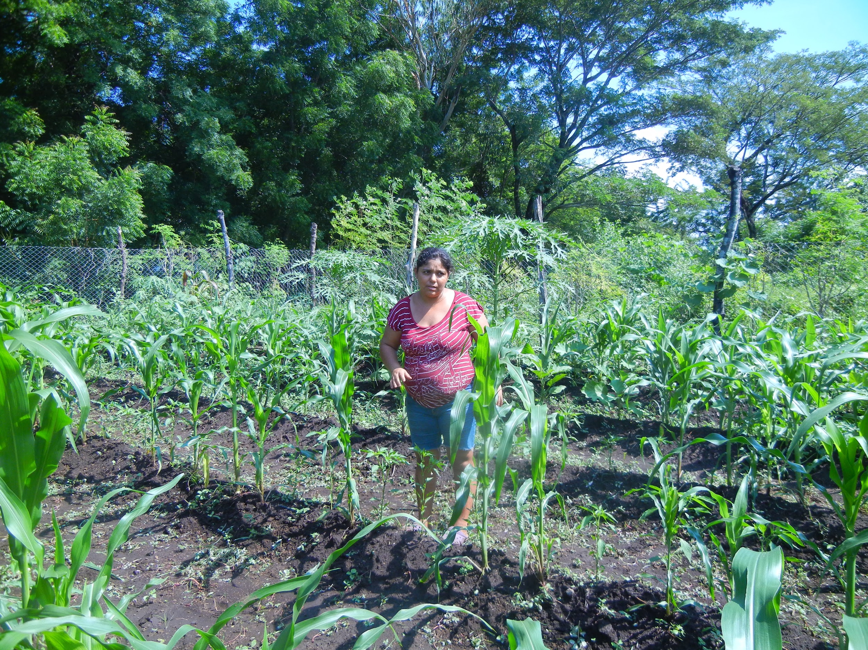
ViviendasLeón’s Experience
Carla Galeano, Troilo
“My name is Carla Galeano and I am 40 years old. I have 2 kids - Deybin and Jonathon - and my husband works as a day laborer. Before I went through Human Capacity Training (HCT), I felt a certain level of depression because women are undervalued, and I did not have a job. We constantly worried about having enough.
When I began to go through HCT, I learned about different values, how to defend my rights and how to better care for my children. After completing HCT, I received a family farm, I did not know how to work the land, but through the trainings and technical visits conducted by Lesbia and Camilo, I learned how to cultivate different types of vegetables and how to use organic methods to control the pests that affect our farms.
My family’s income has improved significantly because of our farm, which has allowed me to cover some of our family’s expenses like paying for the education of my children, improvements to our home, and providing food for my family. My self-esteem has improved thanks to the knowledge acquired during HCT. With my farm, I feel like an entrepreneur and a useful person in my community.
I am happy with ViviendasLeón for making it possible for my family to change our lives for the better and for making me feel like a role model in my community.”

Slide 16
Thank You!
https://viviendasleon.org/

